Slide 1
GLOBAL PARTNERSHIP AGAINST THE SPREAD OF WEAPONS AND MATERIALS OF MASS DESTRUCTION (GP) International Cooperation through the GP EU CBRN Risk Mitigation Centres of Excellence Initiative 10th International Meeting of the National Focal Points Brussels | May 15, 2025

Slide 2
The Global Partnership: A Snapshot
23 years since GP created at Kananaskis Summit: US$20B over 10 years, initial focus on WMD threats in the former Soviet Union
Expanded globally in 2008 / Extended indefinitely in 2011
Since 2002, €26B+ in programming delivered worldwide
Transformative impact on security of vulnerable states against WMD threats – mostly in Global South
Continuing multilateral success story despite erosion of non-proliferation and disarmament architecture
Canada sees 2025 as opportunity for GP's 31 members (30 countries + EU) to renew commitment to its critical work

Slide 3
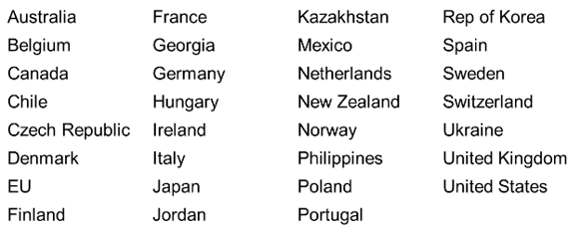
GP Members & Implementers
31 Members (30 Countries + EU)
NB: Russia was expelled following its invasion of Crimea in 2014
Key Implementing Partners
Africa CDC BTWC-ISU IAEA INTERPOL OPCW UNODA UNSGM WINS
ASEAN CTBTO IFBA NTI UNICRI UNODC WHO WOAH (OIE)

Slide 4
GP Working Methods
GP meets 2x per year as the GP Working Group (GPWG)
G7 President (Canada in 2025, France in 2026) shapes GP programming priorities and external engagement
Four sub-working groups develop and implement work plans for concrete projects and initiatives:
Biological Security Working Group (BSWG)
Chemical Security Working Group (CSWG)
Nuclear & Radiological Security Working Group (NRSWG)
CBRN Working Group (CBRNWG)—i.e. cross-cutting issues

Slide 5
Matchmaking
Fundamentally, GP is a donor coordination mechanism
Matchmaking is cornerstone of GP: matches donor funds and in-kind contributions with project proposals from implementers
Calls for proposals usually issued in January and September
In 2024, 424 projects worth €$1.9B were implemented in 159 countries in every region of the world by 18 GP partners:
Australia, Canada, Denmark, EU, Finland, France, Germany, Italy, Japan, Mexico, Netherlands, Norway, Poland, Portugal, Sweden, Switzerland, UK, US
Canada piloting new approach to improve priority setting, paperwork, donor coordination, feedback on proposals

Slide 6
Canada's 2025 Presidency Priorities
Priority 1: Expanding Engagement
Actions: Targeted outreach to potential new members; bolster GP regional initiatives (especially Signature Initiative to Mitigate Biological Threats in Africa—SIMBA)
Priority 2: Tackling Cross-Cutting Threats
Actions: Increased focus on GP's Countering WMD Disinformation Initiative and WMD-relevant technologies
Priority 3: Effective Functioning
Actions: Improve matchmaking process; implement a coordination unit and communications strategy; update core documents and mission

Slide 7
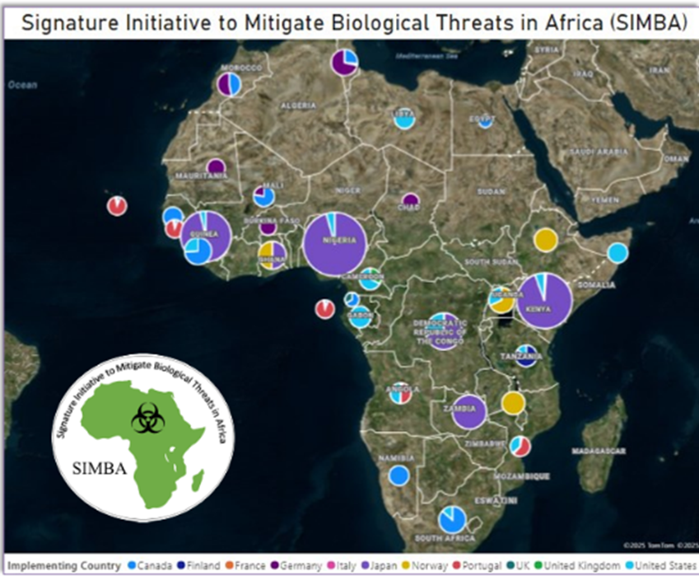
2025 Priority: Spotlight on SIMBA
Launched in 2020
Led by Canada, funded by several GP members
Driven by African partners, especially Africa CDC
Bolsters biosecurity and biosafety measures and standards across continent
Health Security Partnership in Africa: Major component of SIMBA—Africa CDC and WHO improving early warning through strengthened disease surveillance and epidemic intelligence

Slide 8
Spotlight on SIMBA (continued)
Global challenges require global engagement
SIMBA underscores G7 and GP commitment to work with Global South to tackle global challenges together—especially amid flux in donor landscape
As G7 president, Canada committed to making SIMBA a cornerstone of GP strategy to expand engagement into future years
Opportunities for collaboration
EU has robust network and track record in Africa (8 projects valued at €52M over 5 years reported to GP in 2024)
GP and EU CBRN CoE network can leverage each other's investments and relationships to maximize reach and results

Slide 9
Takeaways from GPWG #1 (February 2025)
174 total participants:
21 GP member countries (out of 30) + EU
3 non-GP partner countries: Nigeria, South Africa, Uganda
40 implementing partners (multilateral organizations, NGOs)
Top CBRN challenges for 2025:
Ukraine: Safety and security of nuclear facilities / Use of CW
Syria: Destruction of Assad regime's legacy chemical weapons
North Korea: Active WMD and missile programs
Canada to host GPWG #2 in November (site TBD)

Slide 10
GP Sub-Working Group Meetings
NRSWG: Coordination of Ukraine assistance (Chișinău, 29-30 April)
CSWG: Side meeting at INTERPOL-led Global Congress on Chemical Security & Safety (Amman, 6 May)
BSWG: SIMBA coordination (Addis Ababa + Lisbon, 27-30 May)
Africa CDC’s Biosafety and Biosecurity Strategy (27-28 May)
Health Security Partnership in Africa (29-30 May)
SIMBA Lusophone Initiative workshop (Lisbon, 27-29 May)
CBRNWG: Side meeting at annual Australia Group plenary (Sydney, 14-18 July)

Slide 11
GP–EU CBRN CoE Collaboration
GP and EU CBRN CoE are natural partners...
Both are "one-stop shop" mechanisms to reduce WMD threats, with cross-regional convening power
Full-spectrum assistance: from treaty accession and domestic legislation all the way to forensics and accountability
Heavy overlap: 14 GP members are EU states; GP has projects in almost all CoE partner states
EU CoE Initiative has deep local networks; GP has funding and high-capacity expertise
GP can help mobilize resources and technical assistance to translate National and Regional Action Plans into concrete programming

Slide 12
Canada's Weapons Threat Reduction Program
Canada's flagship contribution to the Global Partnership
€1.1B in programming since 2002
Budget of €50M per year
Active in every region of the world / 144 projects in 2024-25
Implementing partners: multilateral organizations, NGOs, research institutes, GP members, specialized companies

Slide 13
WTRP Objectives and Portfolios
Build international capacity to prevent, detect and respond to WMD threats
Secure dangerous CBRN materials and improve facility security
Improve universalization and national implementation of non-proliferation, arms control, and disarmament (NACD) regimes: Biological & Toxin Weapons Convention, Nuclear Non-Proliferation Treaty, Chemical Weapons Convention, Arms Trade Treaty, etc.
Strengthen global networks and international NACD institutions and initiatives
Objectives
* Includes addition of $5 million/year ongoing under the Indo-Pacific Strategy starting in FY2023-24.
Nuclear & Radiological Security
Biological Security
Chemical Security
CBRN
Cross-Cutting Issues
Conventional Weapons
Portfolios

Slide 14
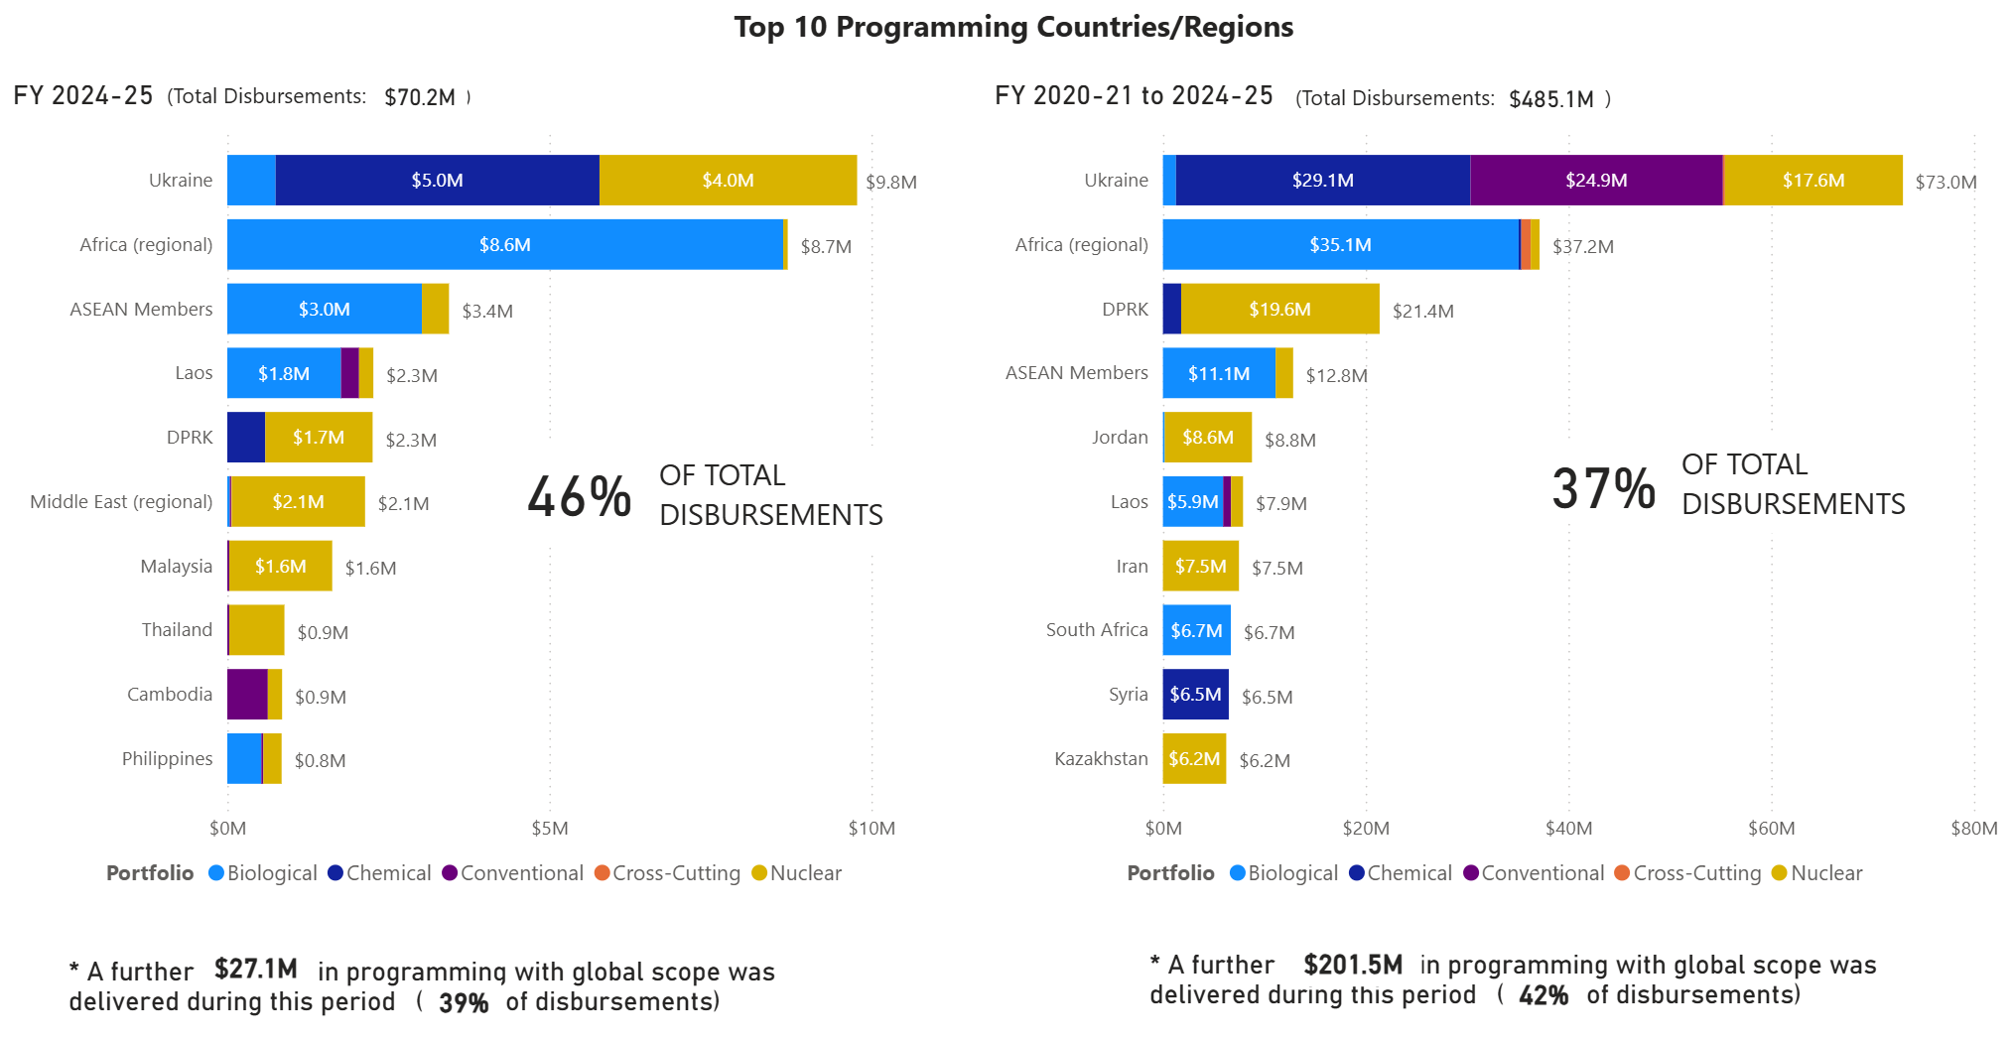
WTRP Top Countries and Regions

