Slide 1
Interagency Cooperation: experience in the Kyrgyz Republic
14 May 2025, Brussels

Slide 2
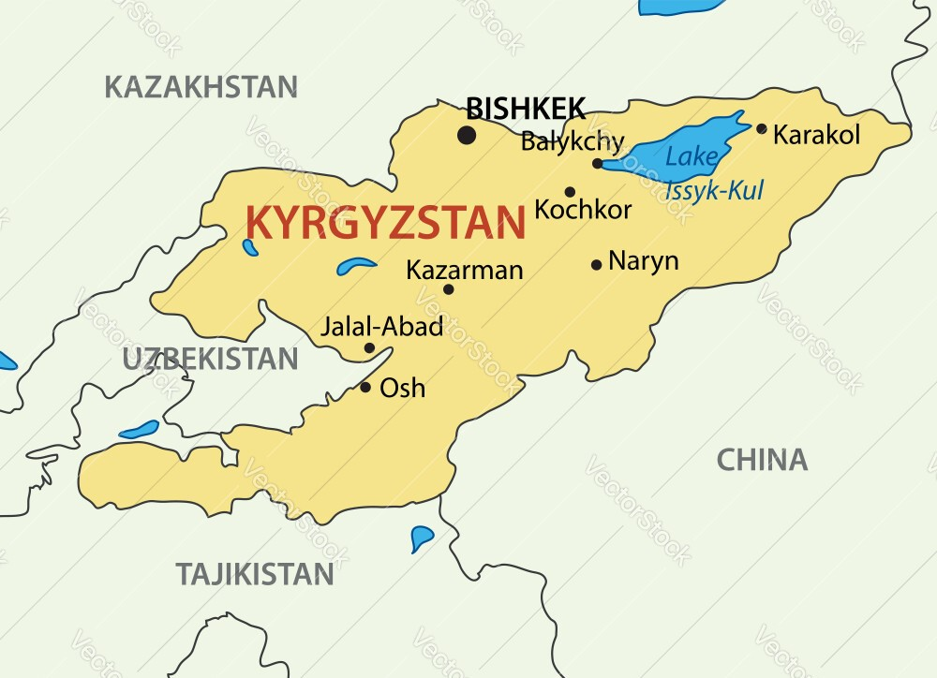
International frameworks
UN Security Council Resolution 1540;
Convention on the Prohibition of the Development, Production and Stockpiling of Bacteriological (Biological) and Toxin Weapons and on their Destruction;
Convention on the Prohibition of the Development, Production, Stockpiling and Use of Chemical Weapons and on Their Destruction;
Basel Convention on the Control of Transboundary Movements of Hazardous Wastes and their Disposal;
Rotterdam Convention on the Prior Informed Consent Procedure for Certain Hazardous Chemicals and Pesticides in International Trade;
Stockholm Convention on Persistent Organic Pollutants (POPs);
UNECE Convention on the Transboundary Effects of Industrial Accidents;
CTBT, CPPNM, CPPNM/A, CSA, RADW, ICSANT.

Slide 3
Interagency Working Group on CBRN Security in the Kyrgyz Republic
Ministry of Emergency Situations;
Ministry of Internal Affairs;
Ministry of Natural Resources, Ecology and Technical Supervision;
Ministry of Health;
State Committee for National Security;
Ministry of Finance;
Ministry of Economy and Commerce;
Ministry of Agriculture;
Ministry of Education and Science;
National Academy of Sciences.

Slide 4
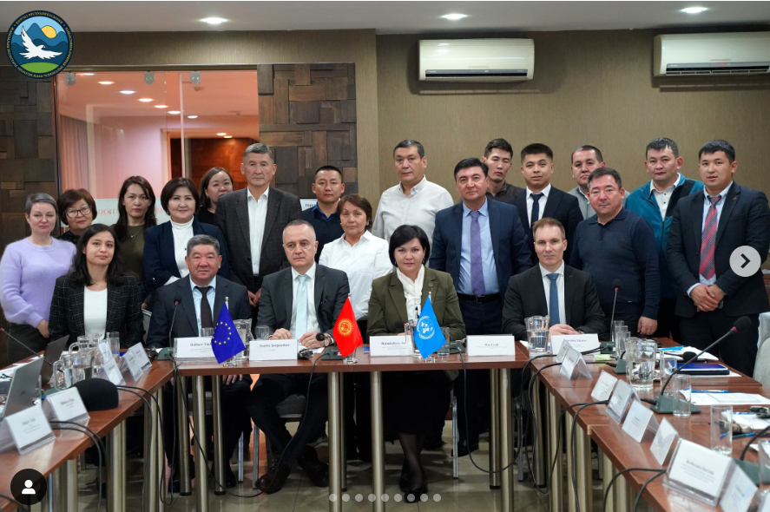
Role of Interagency Cooperation in the Kyrgyz Republic
Threat and risk assessment: Continuous analysis and monitoring
Legal framework: Initiation and participation in the development and updating of the legislative and regulatory framework
Projects and exercises: Proposal of relevant topics and participation in the implementation of projects, activities and events
Sustainability and prospects: Active cooperation at the regional, interregional and global levels
THANK YOU FOR YOUR ATTENTION!

