Slide 1
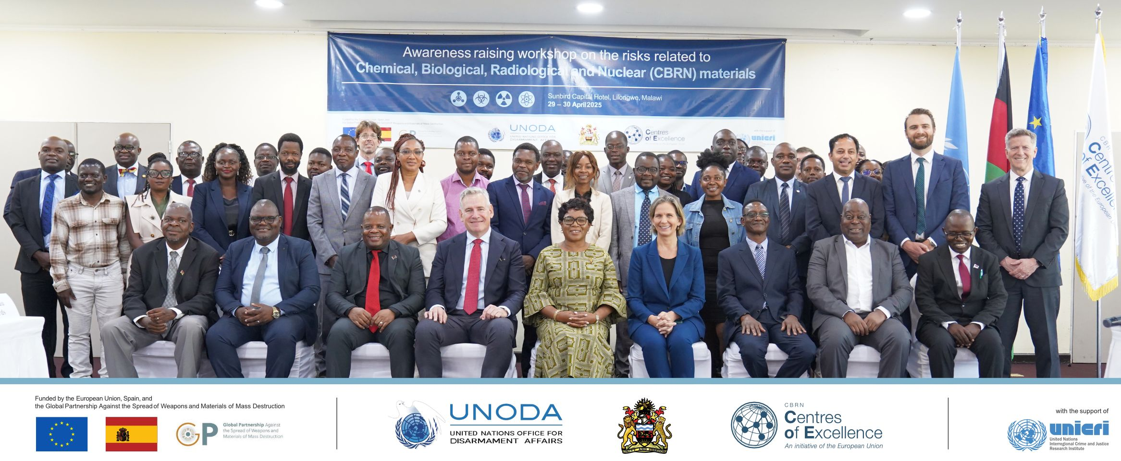
INTERAGENCY COOPERATION: CBRN AWARESS SESSION
BY ABELS MKANDAWIRE, CBRN NFP – MALAWI, 14 MAY 2025, BRUSSELS

Slide 2
DESCRIPTION OF THE EVENT
Raise national awareness to help move implementation of the CBRN NAP
Three partners offered support: EU CBRN CoE, UNSCR1540, BWC-ICU (UNODA)
First, short high level session opened by the Minister of Foreign Affairs, EU Ambassador and Un Resident Coordinator representative
Then technical sessions to
Exchange experiences on CBRN risks
Address the legal frameworks at international and regional levels
Assess Malawi's preparedness and gaps
Over 65 national participants and 15 regional/international presentations
Notes:
Abels: highlight that you requested the three partners to join forces instead of trying to organize three different events.
Explain very briefly what the high level opening session looked like (either the reality or the ideal)

Slide 3
SUCCESSES / OUTCOMES
Urged head of institutions to include NAP activities in their budgets
Positive assurances from Senior officials
National media and Social media exposure
Potential support offers from COMESA, SADC, UNODC, Africa CDC, Brown Univ.
Came up with priority activities from the NAP for the year
Agreed to revive the domestication process of the BWC and CWC
Agreed to include CBRN in the National Disaster Management Structure
Agreed to develop a CBRN Emergency Response Plan

Slide 4
LESSONS LEARNT / RECOMMENDATIONS
Need to start planning early
Not easy to get hold of senior officials
CBRN not high on the priority
Senior officials only available for a short time, so plan the agenda smartly
Make necessary follow-ups
Joint session saves time and resources
Involve the head of your institution if you are not the head
Need continuous engagement with NT and organizing partners.

