Slide 1
Panel 3 Joint Capacity Building Libye -Tunisia joint training session 2025 on the control of CBRN agents at borders LIBYA-TUNISIA by Nuri El Jaiash, CBRN National Focal Point for Libye
14 May 2025, Brussels

Slide 2
HOW WAS THE JOINT TRAINING DECIDED ?

Slide 3
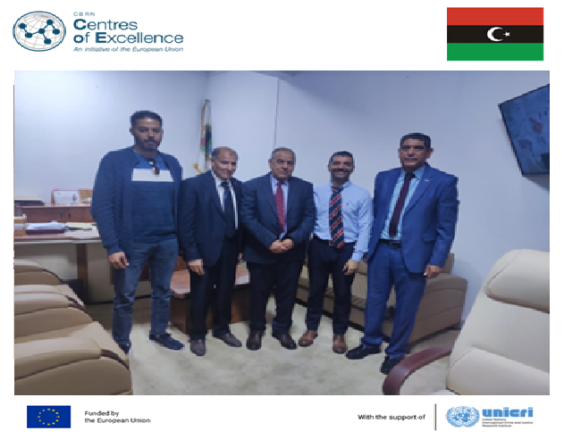
THE FIRST ACTIVITY IN LIBYA STARTED IN APRIL 2024
LIBYA is member of the EU CBRN COE since 2014, but no project was implemented.
First technical mission of the OSA NAS in April 2024 to identify the expectations of Libye.
The CWC, the Detection equipment and the control of chemicals were in the center of the exchanges.

Slide 4
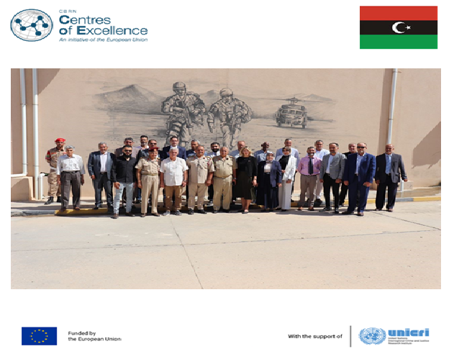
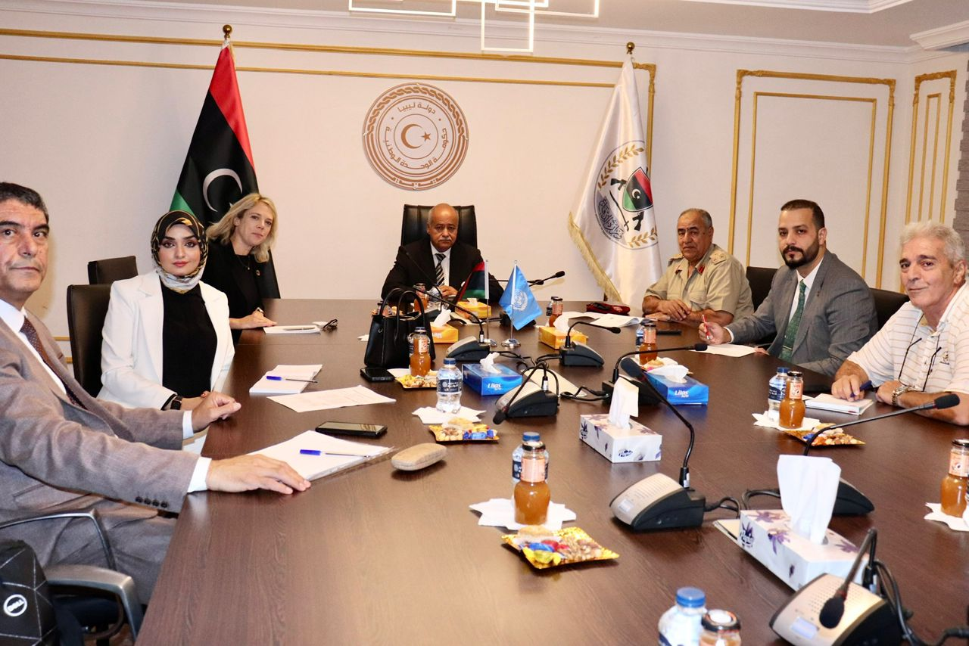
SECOND OFFICIAL VISIT AND ASSESSMENT OF THE CBRN NEEDS: October 2024
Niccolò Maracchi, Deputy Head of Cooperation, Delegation of the European Union to Libya, Julie Busch the UNICRI Regional Coordinator and the OSA NAS.
During the CBRN assessment needs, the CBRN national team requested to organize a joint training session with Libya and Tunisia on the control of the CBRN agents at borders.
Ms. Anne-Sophie Lequarré, the EU programme Manager approved it.

Slide 5
Objectives
Improve capabilities to collect and analyse information on CBRN substances and on the importers and end-users
Enhance the import/export control of CBRN materials at the borders
Enhance cross-border cooperation between Libya and Tunisia
The training was performed by the Libyan and Tunisian trainers and the OSA NAS expert, January and February 2025.

Slide 6
Agenda
The EU and international regulation and conventions of the CBRN agents.
The CBRN national regulations.
The CBRN equipment.
The control of pesticides, drugs and precursors explosives and dual-use agents.
The assessment of the national control at borders.

Slide 7
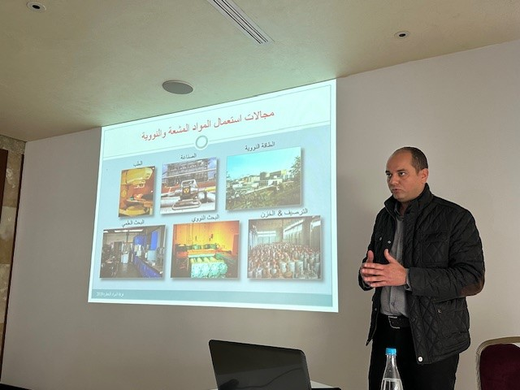
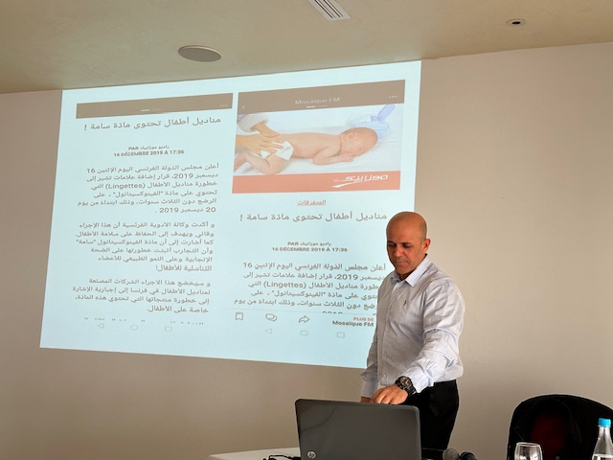
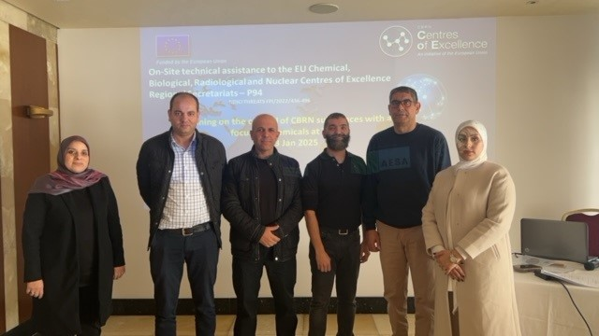
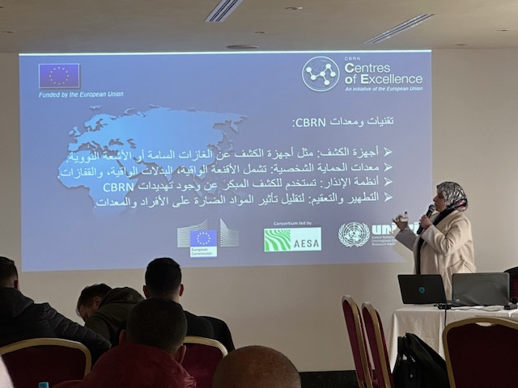
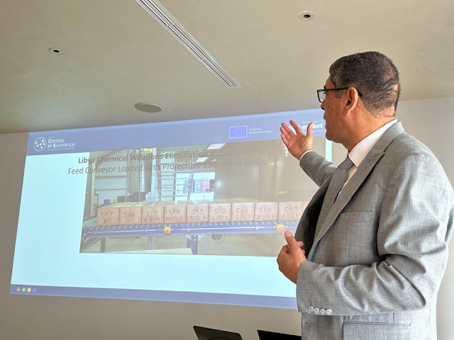
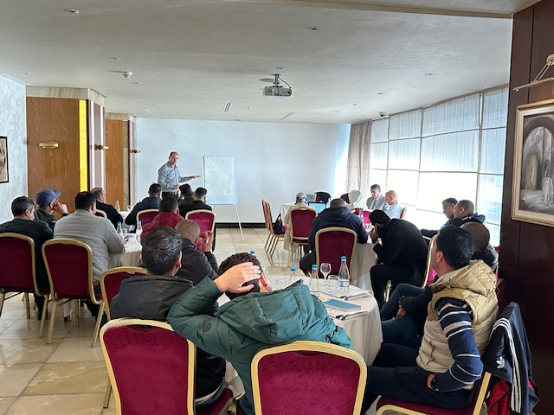
Specific Training for TUNISIA on the Control of CBRN Substances at the borders: January 2025.

Slide 8
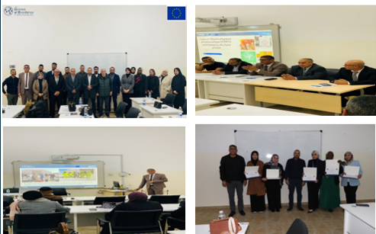
Specific Training for LIBYA on the Control of CBRN Substances at the borders: February 2025.

Slide 9
Results
- Interactive Presentations: Led by experts, these presentations provided in-depth insights into various controls-related topics.
- Case Studies: Real-world scenarios were presented to help participants apply their learning in practical settings.
- Group Discussions: These sessions fostered collaboration and allowed participants to share their experiences and insights.
- Hands-On Exercises: Practical exercises ensured that participants gained experience in key operational procedures.

Slide 10
Lessons learned
GAP analyzis to assess the needs of the CBRN equipment.
Perform new sessions of training with other countries to share the experiences.
Set up the international framework of the dual use CBRN agents.

Slide 11
THANK YOU FOR YOUR ATTENTION

